Slide 1
HieRec: Hierarchical User Interest Modeling for
Personalized News Recommendation
ADVISOR: JIA-LING KOH
PRESENTER: Xiao-Yuan Hung
SOURCE: ACL’21
DATE: 2022/3/15

Slide 2
Outline
1
Introduction
2
Method
3
Experiment
4
Conclusion

Slide 3
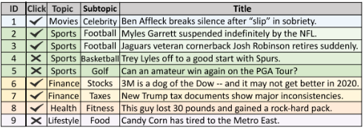
Motivation
Most existing methods learn a single user embedding to represent the overall user interests.
However, user interests are usually very diverse and multi-grained, which are difficult to be accurately modeled by a single user embedding.

Slide 4
Motivation
Most existing methods learn a single user embedding to represent the overall user interests.
However, user interests are usually very diverse and multi-grained, which are difficult to be accurately modeled by a single user embedding.

Slide 5
Motivation
Most existing methods learn a single user embedding to represent the overall user interests.
However, user interests are usually very diverse and multi-grained, which are difficult to be accurately modeled by a single user embedding.

Slide 6
Motivation
Most existing methods learn a single user embedding to represent the overall user interests.
However, user interests are usually very diverse and multi-grained, which are difficult to be accurately modeled by a single user embedding.

Slide 7
HieRec
personalized news recommendation approach with hierarchical user interest modeling.

Slide 8
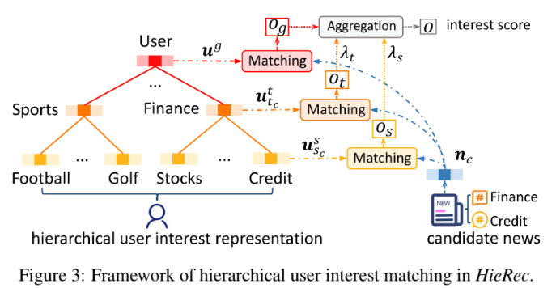


Input
target user
candidate news

Slide 9
Input

Slide 10
Output
interest score

Slide 11
Subtopic-level
interest representation to model overall user interests
coarse-grained user interests in major news topics
fine-grained user interests in different news subtopics

Slide 12
Subtopic-level
fine-grained user interests in different news subtopics

Slide 13
Topic-level
coarse-grained user interests in major news topics

Slide 14
User-level
interest representation to model overall user interests

Slide 15
Interest Matching

Slide 16
Interest Matching

Slide 17
Outline
1
Introduction
2
Method
3
Experiment
4
Conclusion

Slide 18



Hierarchical User Interest Modeling
user’s clicked news in topic i and subtopic j are divided into the same click group
the user has M clicked news.
d is the size of the set.

Slide 19
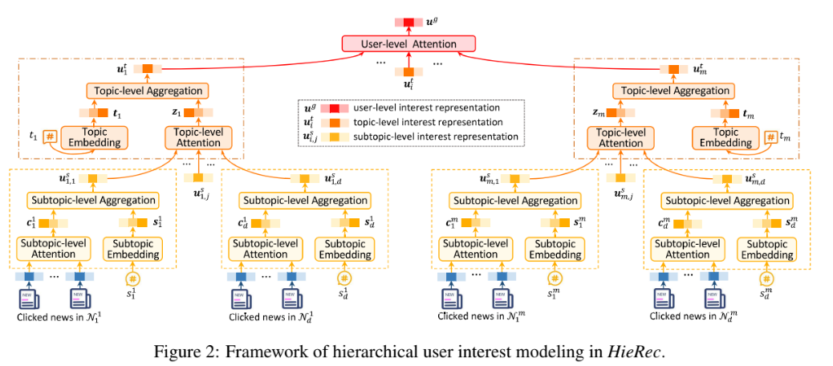
Hierarchical User Interest Modeling
target user

Slide 20
the user has M clicked news.

Slide 21
d is the size of the set.

Slide 22
user’s clicked news in topic i and subtopic j are divided into the same click group

Slide 23
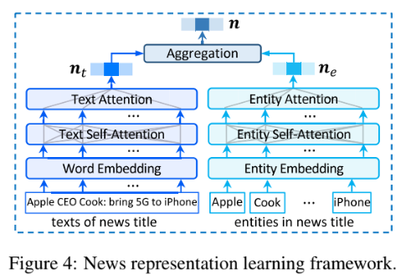
News representation learning framework
News include
topice t
subtopic s
title
  text sequence
  entity sequence
:text representation
:entity representation

Slide 24
News representation

Slide 25
News representation learning framework
News include
topice t
subtopic s
title
  text sequence
  entity sequence

Slide 26
News representation learning framework
:text representation
:entity representation

Slide 27
Hierarchical User Interest Modeling

Slide 28
Hierarchical User Interest Modeling

Slide 29


subtopic-level interest representations

Slide 30
subtopic-level interest representations

Slide 31
subtopic-level interest representations

Slide 32
subtopic-level interest representations

Slide 33


Topic-level interest representations
is the embedding vector for the number of clicked news on subtopic

Slide 34
Topic-level interest representations
is the embedding vector for the number of clicked news on subtopic

Slide 35
Topic-level interest representations
is the embedding vector for the number of clicked news on subtopic

Slide 36
Topic-level interest representations
is the embedding vector for the number of clicked news on subtopic

Slide 37
Topic-level interest representations
is the embedding vector for the number of clicked news on subtopic

Slide 38
Topic-level interest representations
is the embedding vector for the number of clicked news on subtopic

Slide 39

User-level interest representations
is the embedding vector for the number of user’s clicked news on topic

Slide 40
Hierarchical User Interest Matching

Slide 41
Hierarchical User Interest Matching
fine-grained user interests is useful for personalized news recommendations

Slide 42
Hierarchical User Interest Matching
baseball cannot match any fine-grained interests
coarse-grained user interests and overall user interests can match with it.

Slide 43
Hierarchical User Interest Matching
fine-grained user interests is useful for personalized news recommendations
baseball cannot match any fine-grained interests
coarse-grained user interests and overall user interests can match with it.

Slide 44


Hierarchical User Interest Matching
= 0.7
= 0.15

Slide 45
Hierarchical User Interest Matching

Slide 46
Hierarchical User Interest Matching
Users may be more interested in topics that they have clicked more.
Thus, weights based on the ratio of topic

Slide 47
Hierarchical User Interest Matching

Slide 48
Hierarchical User Interest Matching
= 0.15
= 0.7

Slide 49


Loss function
NCE loss
Given a positive sample (a clicked news) in the training dataset O,
random select K negative samples (non-clicked news)

Slide 50
Loss function
0
NCE loss
Given a positive sample (a clicked news) in the training dataset O,
random select K negative samples (non-clicked news)

Slide 51
Outline
1
Introduction
2
Method
3
Experiment
4
Conclusion

Slide 52

Datasets

Slide 53
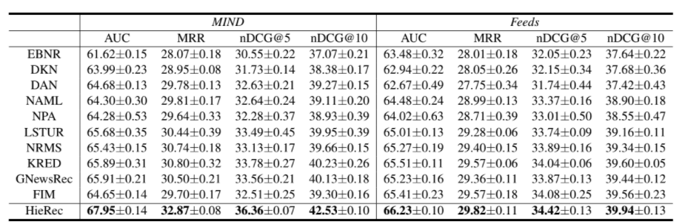
Performance

Slide 54
Performance-singal user embedding

Slide 55
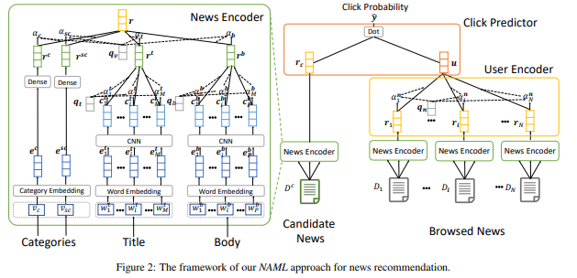
(4) NAML
Notes:
https://arxiv.org/pdf/1907.05576.pdf

Slide 56
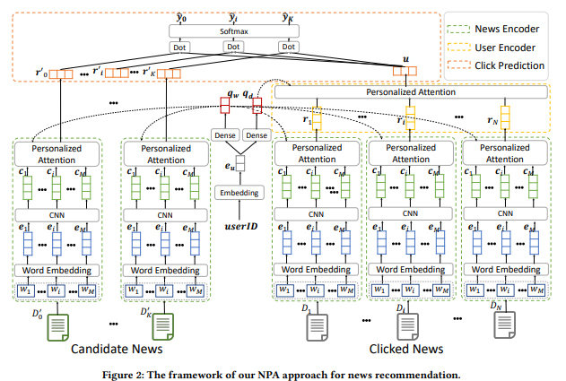
(5)NPA
Notes:
https://arxiv.org/pdf/1907.05559.pdf

Slide 57
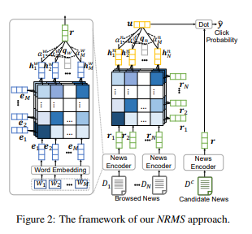
(7) NRMS
Notes:
https://aclanthology.org/D19-1671.pdf

Slide 58
Performance-
semantic relevance of candidate news and user’clicked news

Slide 59
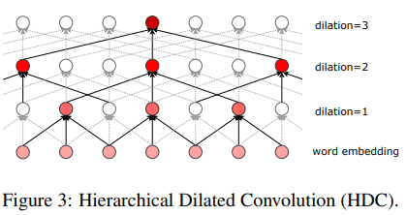
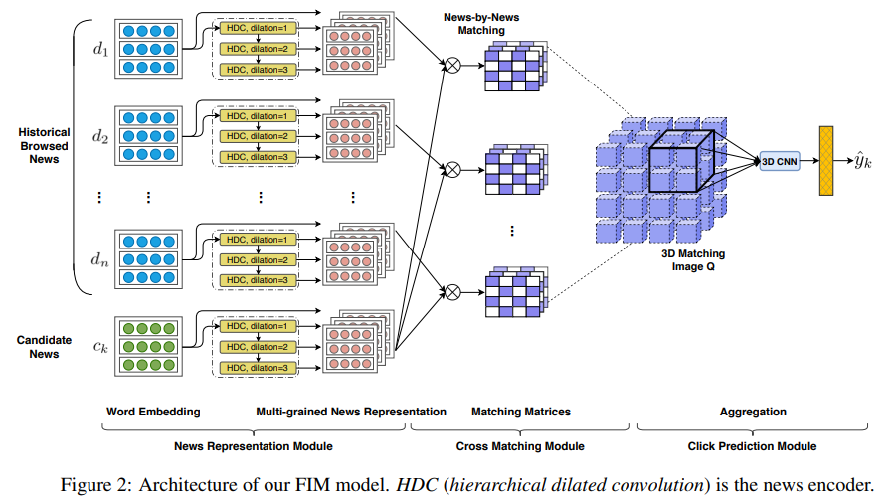
(10) FIM
Notes:
https://aclanthology.org/2020.acl-main.77.pdf

Slide 60
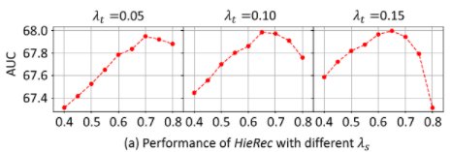
Hyper-parameters

Slide 61
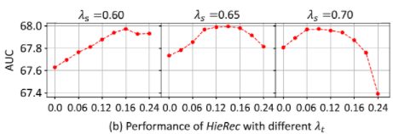
Hyper-parameters

Slide 62
Hyper-parameters
= 0.15
= 0.7

Slide 63
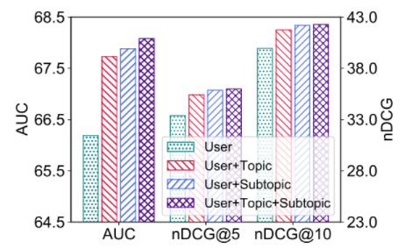
Effect of hierarchical user interest modeling

Slide 64
Outline
1
Introduction
2
Method
3
Experiment
4
Conclusion

Slide 65
Conclusion
Propose a news recommendation method with hierarchical user interest modeling, named HieRec.
HieRec is a three-level hierarchy to represent user interest for matching different aspects and granularity.

Slide 66
reference
Embedding-based news rec- ommendation for millions of users. 275
Deep knowledge-aware network for news recommendation. 499
Deep attention neural network for news recommendation. 79
Neural news recommendation with attentive multi- view learning. 90
Neural news recommendation with long-and short-term user representations. 100
Neural news recommendation with personal- ized attention. 114
Neural news recommendation with multi-head self- attention. 87
Kred: Knowledge-aware document representation for news recommendations. 24
Graph neural news recommen- dation with long-term and short-term interest
modeling. 62
Fine-grained interest matching for neu- ral news recommendation. 37

Slide 67
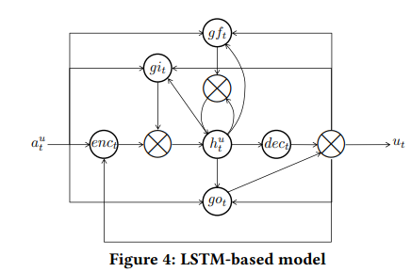
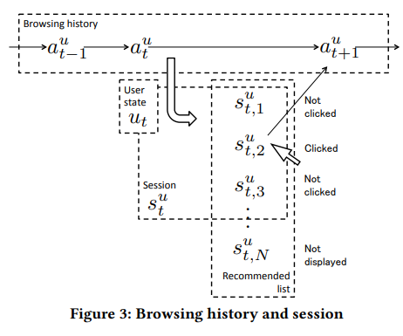
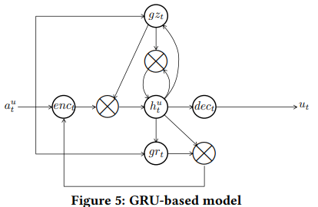
(1) EBNR
Notes:
https://dl.acm.org/doi/pdf/10.1145/3097983.3098108?casa_token=bE8DC7ksjS8AAAAA:7mXgFgrXuMc1VJqzhUV-q0liXBPcw3UCmwIyH20HfSn8gHD8jD2yaQUjS4Fv02pC03p2LN65wv0

Slide 68
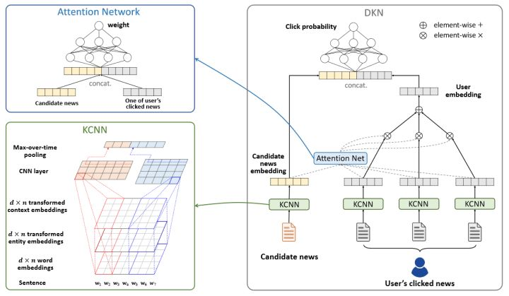
(2) DKN
Notes:
https://arxiv.org/pdf/1801.08284.pdf

Slide 69
(4) NAML
Notes:
https://arxiv.org/pdf/1907.05576.pdf

Slide 70
(5)NPA
Notes:
https://arxiv.org/pdf/1907.05559.pdf

Slide 71
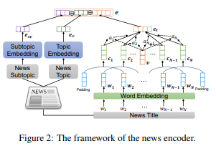
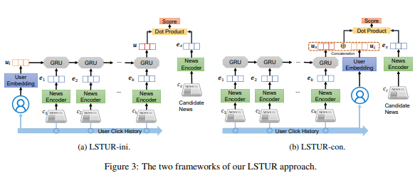
(6) LSTUR
Notes:
https://aclanthology.org/P19-1033.pdf

Slide 72
(7) NRMS
Notes:
https://aclanthology.org/D19-1671.pdf

Slide 73
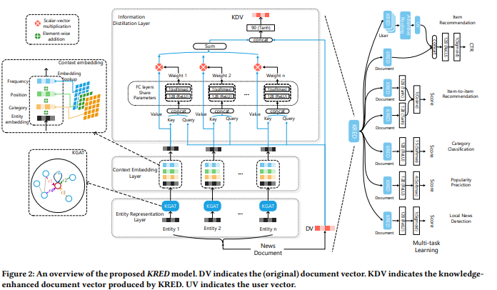
(8) KRED
Notes:
https://arxiv.org/pdf/1910.11494.pdf

Slide 74
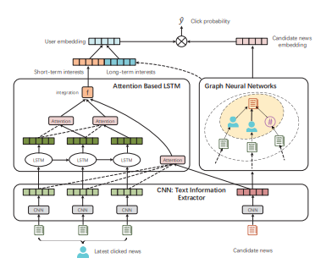
(9) GNewsRec
Notes:
https://arxiv.org/pdf/1910.14025.pdf

Slide 75
(10) FIM
Notes:
https://aclanthology.org/2020.acl-main.77.pdf

